Slide 1
RECURRENT NEURAL NETWORKS (RNNs)

Slide 2
The Hopfield Network, which was introduced in 1982 by J.J. Hopfield, can be considered as one of the first network with recurrent connections
The decision a recurrent net reached at time step (t-1) affects the decision it will reach one moment later at time step (t).
So recurrent networks have two sources of input, the present and the recent past, which combine to determine how they respond to new data, much as we do in life.

Slide 3
Neural networks can be classified as:
Static networks : Output can be calculated directly from the input through feedforward connections.
Dynamic networks : Output depends not only on the current input to the network, but also on the current or previous inputs, outputs or states of the network.
Dynamic Neural Networks (DNN)/RNN have, in comparison to static neural networks, more complex architectures.

Slide 4
A neural network usually takes an independent variable X (or a set of independent variables ) and a dependent variable Y (or a set of dependent variables ) then it learns the mapping between X and Y ( Training)
Once training is done , we give a new independent variable to predict the dependent variable.
That’s all most of machine learning is (supervised).
what if the order of independent variables matter???

Slide 5
If we consider 3 set of data,{(110)(010)(011)} then the order in which it is given is important i.e. the sequence of data.
In feed forward network sequence is not important, random selection is allowed.
In RNNs sequence is important

Slide 6
RNNs are a type of artificial neural network that are able to recognize and predict sequences of data such as text, genomes, handwriting, spoken word, or numerical time series data. They have loops that allow a consistent flow of information and can work on sequences of arbitrary lengths.
Using an internal state (memory) to process a sequence of inputs, RNNs are already being used to solve a number of problems:
Language translation and modeling
Speech recognition
Image captioning
Time series data such as stock prices to tell you when to buy or sell
Autonomous driving systems to anticipate car trajectories and help avoid accidents.

Slide 7
Normal FF Neural network does not follow the order, so when we tackle the real world problems where the order matters , we need Recurrent Neural Networks.
In which data the order matter in our ML space ????
Natural Language Data where the order of words matter
Speech data
Time series data
Video/Music Sequences data
Stock markets data etc….
How RNNs solve “order matters” data??????

Slide 8
They provide the possibility to analyze time-dependent data, since the network elements have special interconnections.
This means that once the input data are transferred to a certain network element (e.g. hidden layer of neurons), they are memorized and integrated with subsequent inputs.
Past information is therefore used to predict both current and future system states.

Slide 9
Recurrent networks are distinguished from feedforward networks by that feedback loop are connected to their past decisions, ingesting their own outputs moment after moment as input.
The flexibility of DNNs comes from usage of different processing elements that contain feedback and delay line taps to express dynamic behavior
Adding memory to neural networks has a purpose: There is information in the sequence itself, and recurrent nets use it to perform tasks that feedforward networks can’t.

Slide 10
Sequence Prediction is…important, overlooked, and HARD
Sequence prediction is different to other types of supervised learning problems.
The sequence imposes an order on the observations that must be preserved when training models and making predictions.
There are 4 main types of sequence prediction problems:

Slide 11
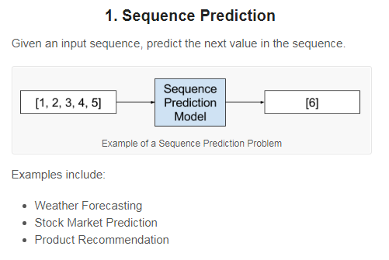

Slide 12
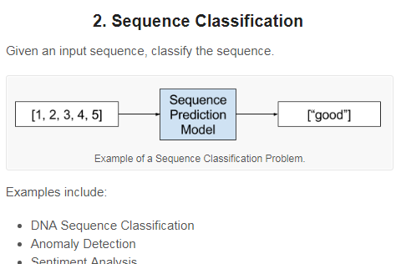

Slide 13
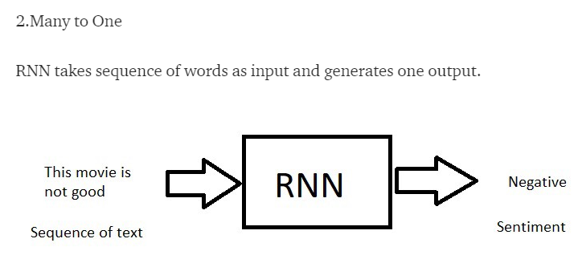
Many to one approach could be to label each image of a video sequence, handle a sequence of images (for example a video) and produce one sentence for it

Slide 14
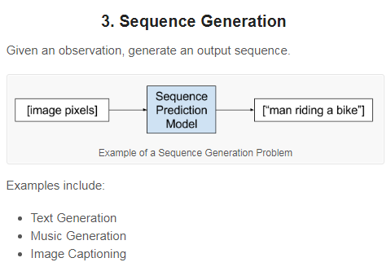

Slide 15
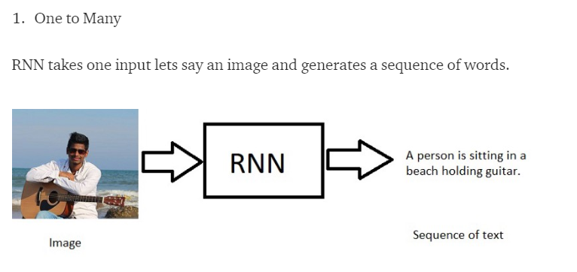
label a image with a sentence.

Slide 16
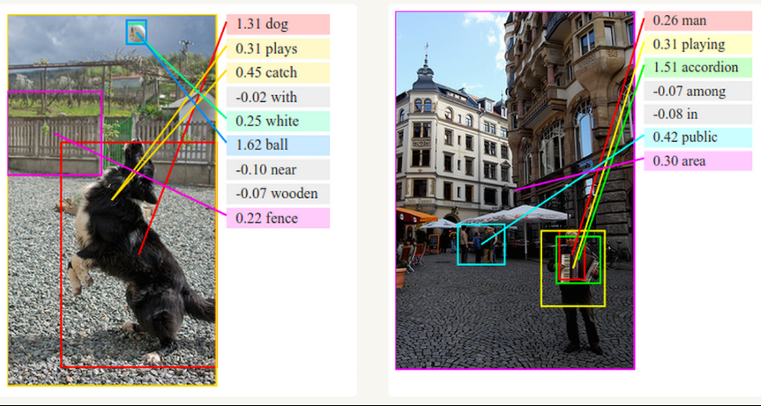

Slide 17
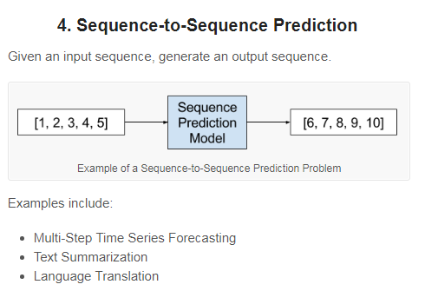

Slide 18
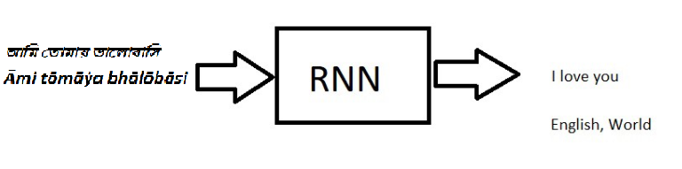
Many to Many

Slide 19
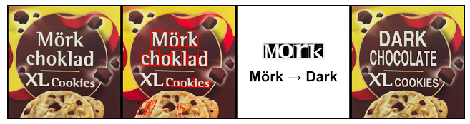
Automatic text translation
This is called instant visual translation
LSTM networks are used.

Slide 20
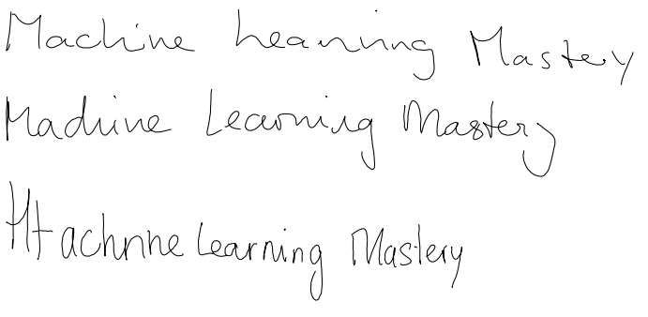
Automatic Handwriting Generation
Given a corpus of handwriting examples, it generates new handwriting for a given word or phrase.

Slide 21

RNN in Music
http://www.hexahedria.com/2015/08/03/composing-music-with-recurrent-neural-networks/
This audio is generated by RNN network(LSTM is used)

Slide 22
Predicting the sound
RNN predicts the sound of from video sequence
This is used in filling the sound in mute videos.
Convolutional and LSTM networks are used.

Slide 23
APPLICATIONS OF
RNN

Slide 24
Speech and audio signals continuously vary over time. The inherent sequential and time varying nature of audio signals make RNNs the ideal model to learn features in this field.
Speech recognition, speech emotion recognition, speaker identification
RNNs have also shown promising results for image labeling, image modeling, and handwriting recognition, video description generation.

Slide 25
Few applications include:
Automatic speech recognition
Automatic speech understanding
Automatically answer questions about objects in a photograph.
Automatic Game Playing
(Google Translate), speech recognition (Cortana) and language generation.

Slide 26
Few Recurrent Neural Network Types
ELMAN NETWORKS
JORDAN NETWORKS
HOPFIELD NETWORK
LIQUID STATE MACHINES (LSM)
ECHO STATE NETWORKS(ESN)
LONG SHORT TERM MEMORY(LSTM)
GATED RECURRENT UNITS(GRU)

Slide 27
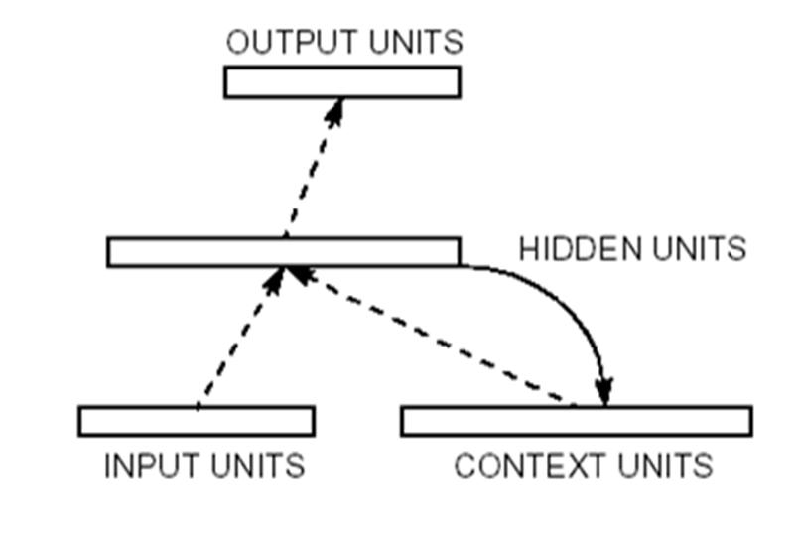
The Simple Recurrent Network (SRN) was conceived and first used by Jeff Elman, and was first published in a paper entitled Finding structure in time (Elman, 1990).

Slide 28
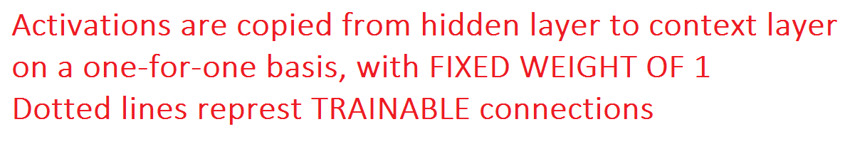
Context units remember the previous internal state.
Hidden units have the task of mapping both an external input and also the previous internal state to some desired output

Slide 29
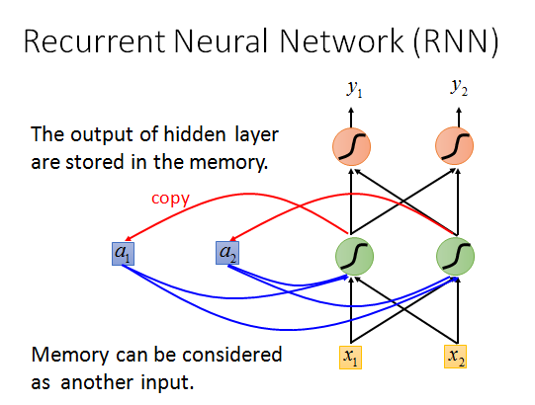
Hidden and Context unit serve as Short term Memory

Slide 30
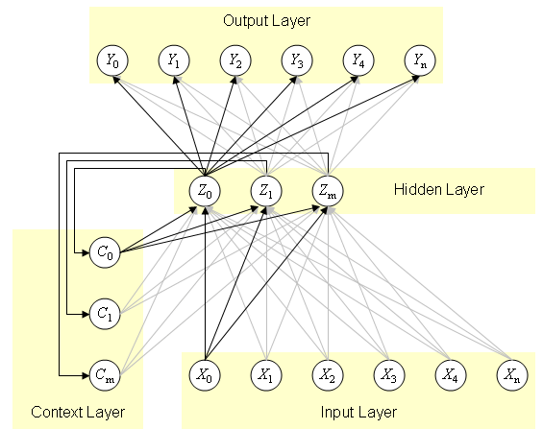

Slide 31
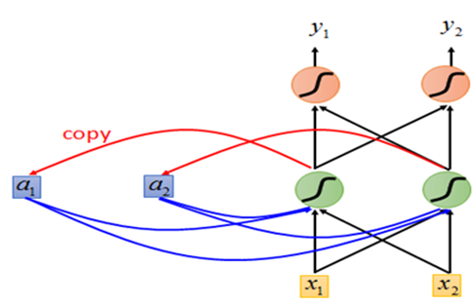
Identify Variables and Parameters

Slide 32
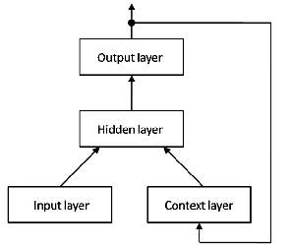
JORDAN NETWORK
Jordan networks are similar to Elman networks. The context units are fed from the output layer instead of the hidden layer. The context units in a Jordan network are also referred to as the state layer.

Slide 33
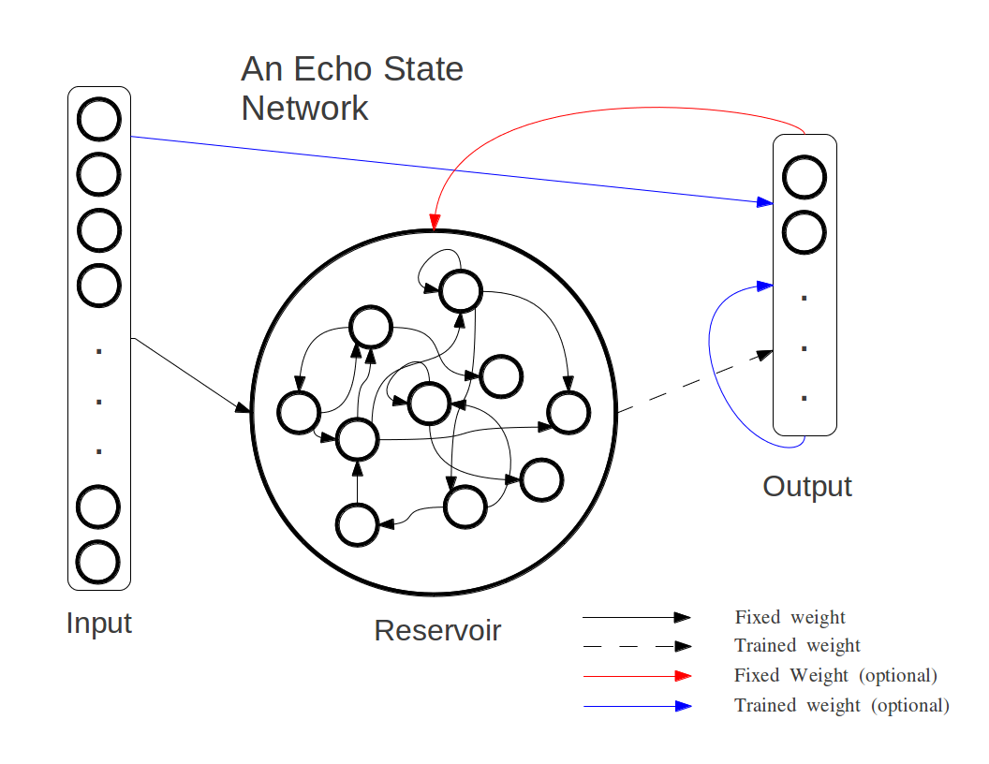

Slide 34
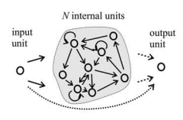
ECHO STATE NETWROK

Slide 35
When do you need to use a Recurrent Neural Network ?
“Whenever there is a sequence of data and
that temporal dynamics that connects the data is more important than the spatial content of each individual frame.”

Slide 36
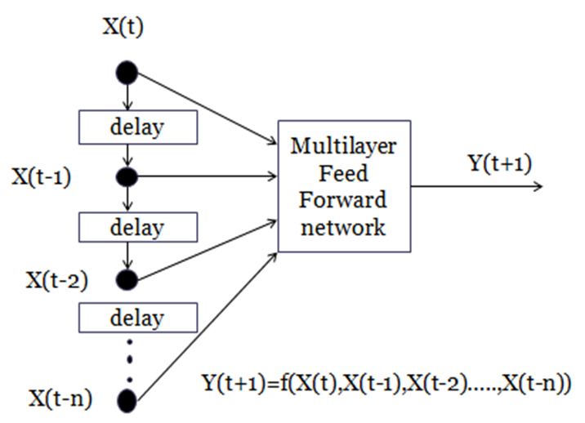
TDNN(Time Delay neural networks) - particular case of feedforward neural network architecture to capture temporal dynamics
The response at time t is based on the previous inputs .

Slide 37
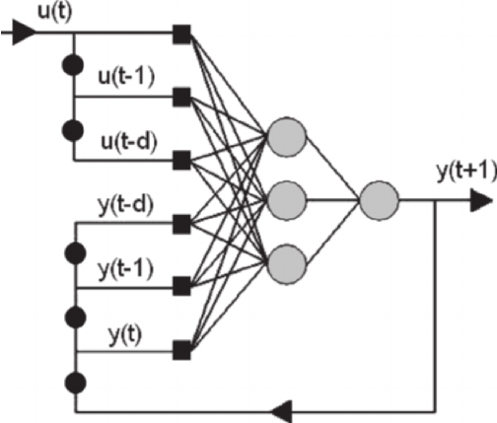
RNN : Output depends on previous inputs as well as previous outputs

Slide 38
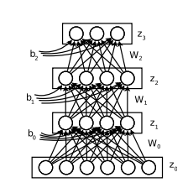
Name of this network ?

Slide 39
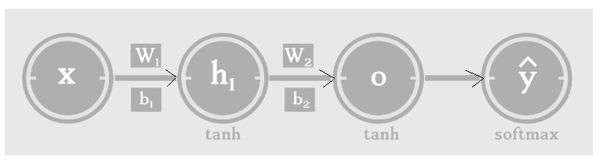
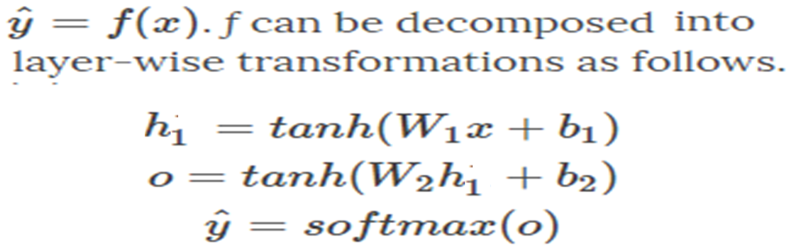
Feed-forward neural networks and it’s variants like Convolutional Networks, have static architecture.
weights (W)for every hidden layers are different.

Slide 40
To understand the architecture and data flow,
ANN can be expressed as a
Directed Acyclic Graph(DAG).
A directed acyclic graph (DAG) is a directed graph that contains no cycles.

Slide 41
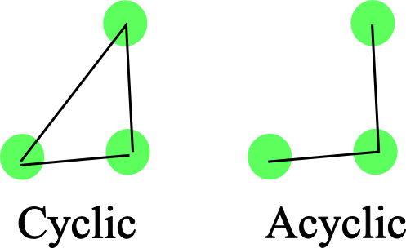

Slide 42
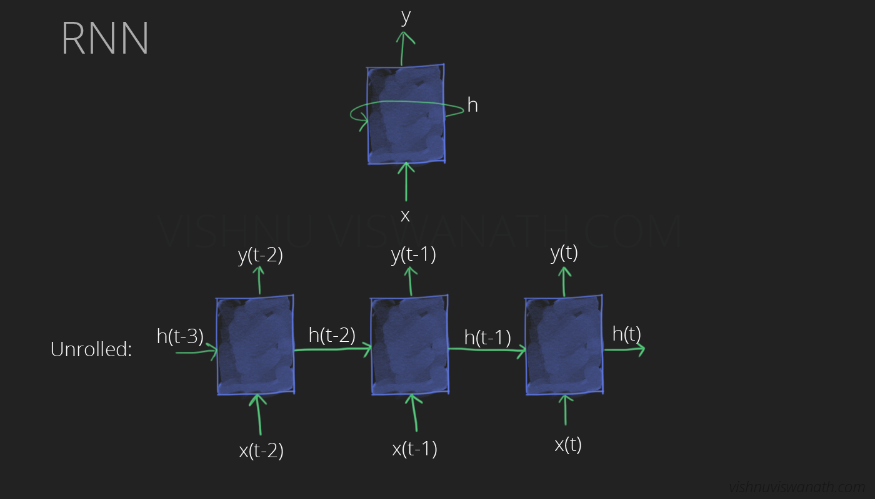
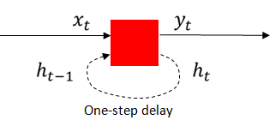
Why can’t we draw an RNN as a DAG?
Because RNNs have cycles in them.
To understand RNNs, we need to remove these cycles and draw the network as a DAG [ UNFOLDING]

Slide 43
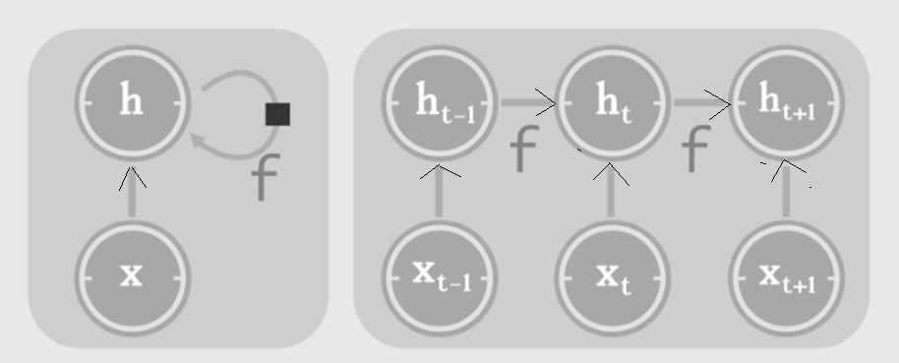
Unfolding
This produces a DAG (directed acyclic graph)
Which supports backpropagation.
its size depends on the input sequence length.
CYCLIC ACYCLIC

Slide 44
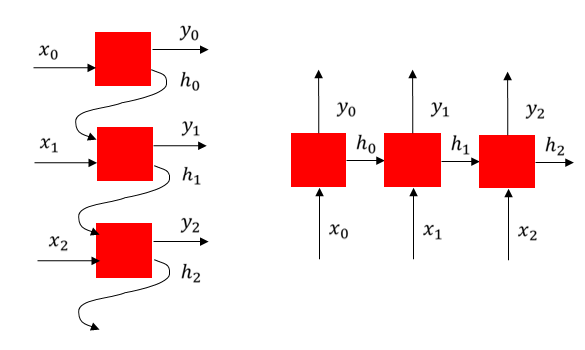

Slide 45
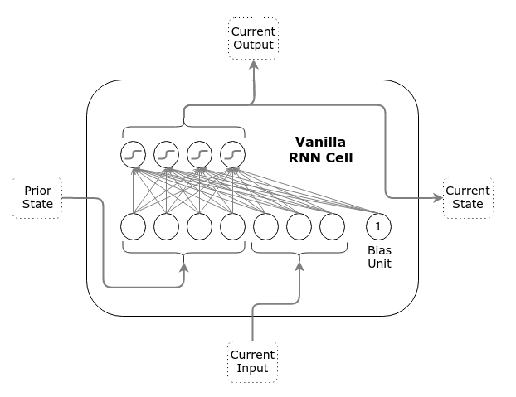
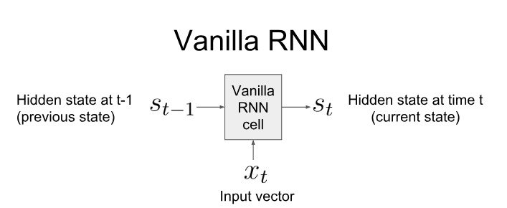
Can also write as h_{t} h_{t-1}

Slide 46
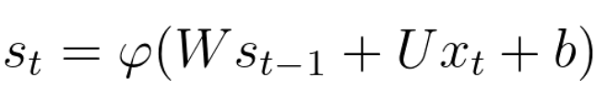
2 state size, 3 input size

Slide 47
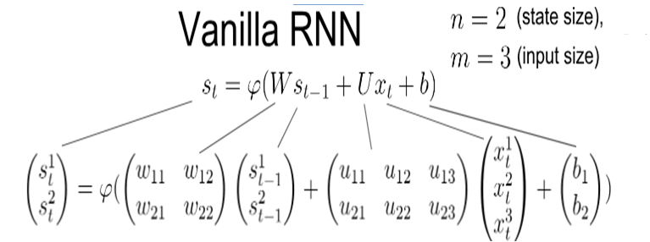
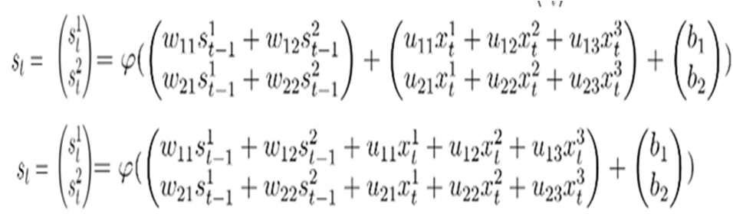

Slide 48
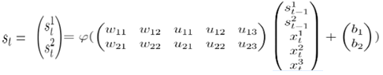
Single layer network

Slide 49
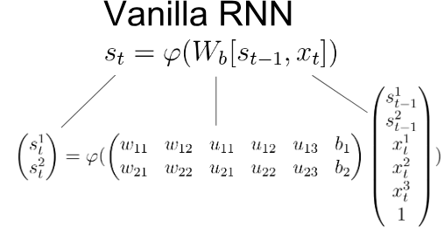
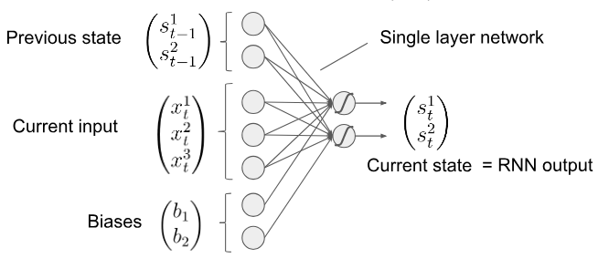

Slide 50
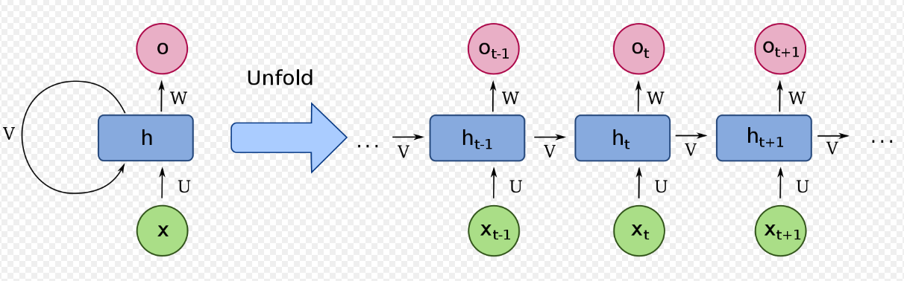
The RNN has: sequential input, sequential output, multiple timesteps, and multiple hidden layers.
Unlike FFNN , here we calculate hidden layer values not only from input values but also previous time step values

Slide 51
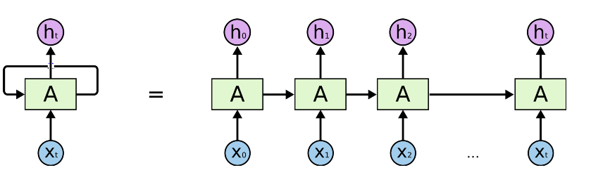
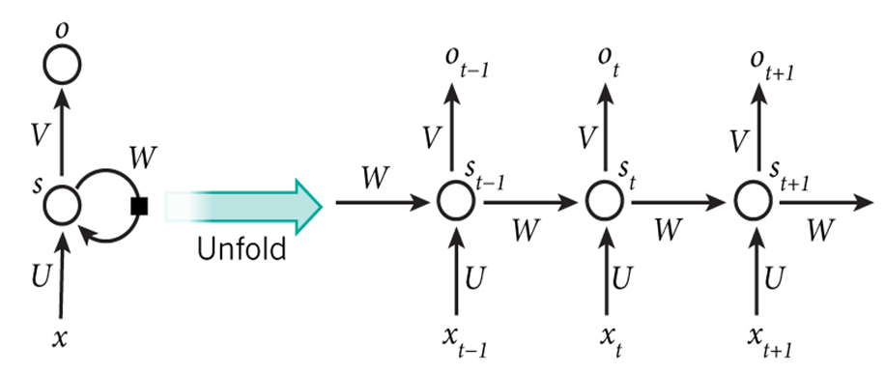
s_{t} = f(Ux_{t} + W s_{t-1})
o_{t} = g( V s_{t} )
Notice: the same function and the same set of parameters are used at every time step.

Slide 52
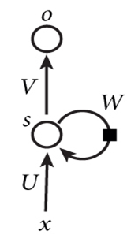
s_{t} = f(Ux_{t} + W s_{t-1})
o_{t} = g(Vs_{t} )
x_{t} : Input at time t
s_{t} : Hidden state at time t (memory of the network)
f : Activation function ( e.g tanh, ReLUs)
U,V,W : Network Parameters( unlike FFN, RNN shares the same parameters across all time steps)
g: Activation function for the output layer ( typically a softmax function)
O_{t}: Output of network at time t

Slide 53
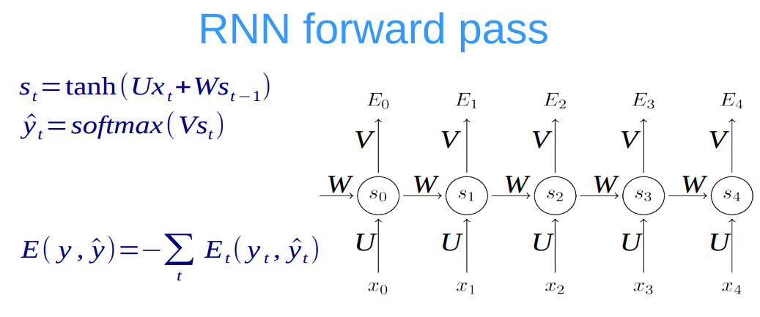

Slide 54
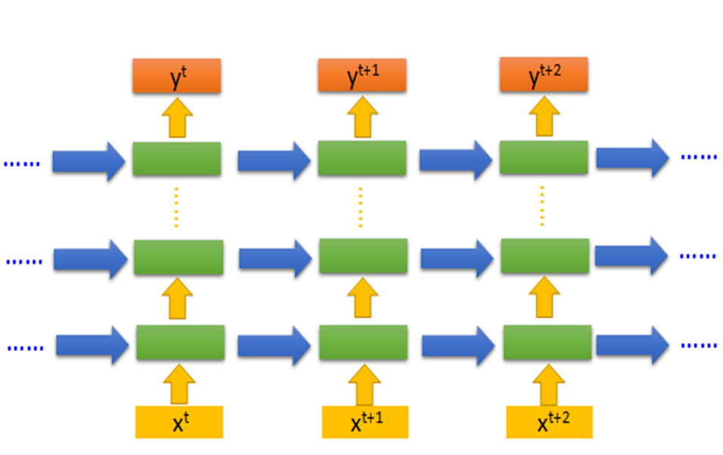
DEEP Recurrent Neural Networks (RNN)

Slide 55
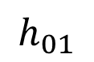
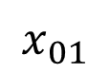
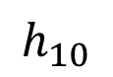
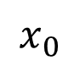
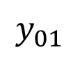
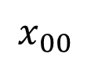
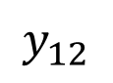
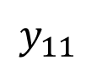










Often layers are stacked vertically (deep RNNs):
RNN structure
$$y_{10}$$
$$y_{11}$$
$$y_{12}$$
$$h_{10}$$
$$h_{11}$$
$$h_{12}$$
Same parameters at this level
$$x_{00}$$
$$x_{01}$$
$$x_{02}$$
≠
Abstraction
Higher level features
$$y_{00}$$
$$y_{01}$$
$$y_{02}$$
$$h_{00}$$
$$h_{01}$$
$$h_{02}$$
Same parameters at this level
$$x_{0}$$
$$x_{1}$$
$$x_{2}$$
Time

Slide 56
Training RNNs
RNN training is similar to training a traditional Neural Network. using the backpropagation algorithm, but with a little twist.
“Vanilla" refers to the name given to the standard backpropagation algorithm.
Because the parameters are shared by all time steps in the network, the gradient at each output depends not only on the calculations of the current time step, but also the previous time steps.
gradient at t=4 would need to backpropagate 3 steps and sum up the gradients.
This is called Backpropagation Through Time (BPTT).

Slide 58


TRAINING A SIMPLE RECURRENT NETWORK

Slide 59
Back propagation through time(BPTT)
Unfolding an RNN in time and using the extended version of backpropagation.

Slide 60
General BPA
BPTT (Back propagation through Time)
Present a training input pattern and propagate it through the network to get an output.
Compare the predicted outputs to the expected outputs and calculate the error.
Calculate the derivatives of the error with respect to the network weights.
Adjust the weights to minimize the error.
Repeat.
Present a sequence of timesteps of input and output pairs to the network.
Unroll the network then calculate and accumulate errors across each timestep.
Roll-up the network and update weights.
Repeat.
BPTT can be computationally expensive as the number of timesteps increases.

Slide 61

Activation Function : Logsigmoid
p 70 of Behra book ”Intelligent Systems and control”

Slide 62
FORWARD PASS : Compute the response of the sequence y(1) to y(5), given the sequence x(0) to x(4), and y(0)
BACKWARD PASS
compute the error e(5)= y ^{d}(5) – y(5)
δ₅ = y(5)(1-y(5)) e(5)
Δw⁵ =ηδ₅ x(4),
Δg⁵ =ηδ₅ y(4),
3. Compute e(4), e(3), e(2) , and e(1)
e(4)= y ^{d}(4) – y(4)
δ₄ = y(4)(1-y(4)) [δ₅ g + e(4)];
Δw⁴ =ηδ₄ x(3),
Δg⁴ =ηδ₄ y(3),

Slide 63
e(3)= y ^{d}(3) – y(3)
δ₃ =y(3)(1-y(3)) [δ₄ g + e(3)] ;
Δw³ =ηδ₃ x(2),
Δg³ =ηδ₃ y(2),
e(2)= y ^{d}(2) – y(2)
δ₂ =y(2)(1-y(2)) [δ₃ g + e(2)] ;
Δw² =ηδ₂ x(1),
Δg² =ηδ₂ y(1),
e(1)= y ^{d}(1) – y(1)
δ₁ =y(1)(1-y(1)) [δ₂ g + e(1)];
Δw¹ =ηδ₁ x(0),
Δg¹ =ηδ₁ y(0),

Slide 64




Slide 65

Output: y(t+1)=f{w. x(t)+g. y(t)}

Slide 66


Backward Pass :
e(2)= Y_{d}(2) - Y(2) = 0.75 - 0.5575 = 0.1924
δ2= e(2)×Y(2)×(1-Y(2))
= 0.1924 × 0.5575 × 0.4425
= 0.0474
e(1)= Y_{d}(1) - Y(1) =0.6 - 0.5037 = 0.0963
δ1= Y(1)×(1-Y(1))×[e(1)+δ2×g]
= 0.5037×0.4963×[0.0963+0.0474×0.4]
=0.0288

Slide 67
δ2=0.0474; δ1= 0.0288
Δw₂ =η×δ2×X(1) = 0.5×0.0474×0.1 = 0.00237
Δg₂ = η×δ2×Y(1)= 0.5×0.0474×0.5037 = 0.0119
Δw₁ =η×δ1×X(0) =0.5×0.0288×0.0 =0.0007
Δg ₁= η×δ1×Y(0) =0.5×0.0288×0=0

Slide 68
Truncated BPTT
It processes the sequence one timestep at a time, and every k1 timesteps, it runs BPTT for k2 timesteps, so a parameter update can be cheap if k2 is small.
Consequently, its hidden states have been exposed to many time steps and so may contain useful information about the far past.

Slide 69
Truncated BPTT steps :
1 for t from 1 to T do
2 Run the RNN for one step, computing h_{t} and z_{t}
3 if t divides k₁ then
4 Run BPTT(calculate new weights) from t down to t − k₂
5 end if
6 end for

Slide 70


LOSS FUNCTION

Slide 71
LOSS FUNCTION
Loss function evaluates performance of the network by comparing the output ‘y’ with corresponding target ‘t’
Selection of loss function is problem dependent.
Some popular loss functions are :
Euclidean distance (y-t)² for forecasting of real values
3. Cross-entropy : for classification problems.

Slide 72
The problem with squared error loss in the classification setting is that it doesn’t distinguish bad predictions from extremely bad predictions.
If target = 1, then a prediction of y = 0.01 has roughly the same squared-error loss as a prediction of y = 0.00001, even though in some sense the latter is more wrong.
The problem with squared error loss is that it treats y=0.01 and y=0.00001 as nearly equivalent.
from the perspective of optimization, the fact that the losses are nearly equivalent is a big problem.

Slide 73
Log loss is used when we have {0,1} response.
Log-loss can be useful when your goal is not only say if an object belongs to class A or class B, but provide its probability (say object belong to class A with probablitity 30%).

Slide 74
Cross-Entropy is a Loss function which makes these very different
If t = 1, then a prediction of y = 0.01 has L_{CE} (0.01, 1) = 4.6
A prediction of y = 0.00001 has L_{CE} (0.00001, 1) = 11.5,
so cross-entropy treats the latter as much worse than the former.
The single equation incorporating both cases of t=1 and t=0 is :

Slide 75

Cross-entropy loss increases as the predicted probability diverges from the actual label.
So predicting a probability of .012 when the actual observation label is 1 would be bad and result in a high loss value.
A perfect model would have a log loss of 0.

Slide 76
The problem of exploding or vanishing gradients in RNNs
What happens to the magnitude of the gradients as we backpropagate through many layers?
If the weights are small, the gradients shrink exponentially.
If the weights are big the gradients grow exponentially.
Typical feed-forward neural nets can cope with these exponential effects because they only have a few hidden layers.

Slide 77
In RNNs for large time sequence input,
- the influence of a given input on the hidden/output layer either decays or blows up exponentially as it cycles around the network's recurrent connections.
can avoid this by initializing the weights very carefully.
Even with good initial weights, its very hard to detect whether the current target output depends on an input from many time-steps ago.
So RNNs have difficulty dealing with long-range dependencies.

Slide 78


Slide 79
If Error gradient explodes backpropagation will not work because we will get NaN values for the gradient at early layers. An easy solution for this is to clip the gradient to a maximum value, as proposed by Mikolov (2012) and reasserted in Pascanu et al. (2013). This works in practice to prevent NaN values and allows training to continue.
https://r2rt.com/written-memories-understanding-deriving-and-extending-the-lstm.html

Slide 80


Recurrent Neural Networks work just fine when we are dealing with short-term dependencies. That is when applied to problems like:
vanilla RNNs fail to understand the context behind an input. Something that was said long before, cannot be recalled when making predictions in the present.

Slide 81


Slide 82
Few ways to combat the vanishing gradient problem.
Proper initialization of the weight matrix can reduce the effect of vanishing gradients.
Regularization[ penalizes large weights].
use ReLU instead of sigmoid activation functions. The ReLU derivative is a constant of either 0 or 1, so it isn’t as likely to suffer from vanishing gradients.
An even more popular solution is to use Long Short-Term Memory (LSTM) or Gated Recurrent Unit (GRU) architectures.

Slide 83

VANILLA RNN
h_{t} = f(Ux_{t} + Wh_{t-1})
o_{t} = g(Vh_{t} ) f &g are activation functions
Vanilla RNNs trained with BPTT have difficulties learning long-term dependencies (e.g. dependencies between steps that are far apart) due to what is called the vanishing/exploding gradient problem.
LSTMs, a certain type of RNNs were specifically designed to overcome this

Slide 84
When we arrange our calendar for the day, we prioritize our appointments . If in case we need to make some space for anything important we know which meeting could be canceled to accommodate a possible meeting.
In RNNS there is no consideration for ‘important’ information and ‘not so important’ information.
LSTMs on the other hand, make small modifications to the information by multiplications and additions.

Slide 85
LSTM

Slide 86
Long Short Term Memory networks ( called “LSTMs”) – are a special kind of RNN, capable of learning long-term dependencies.
They were introduced by Hochreiter & Schmidhuber (1997)
Motivation behind LSTM is to resolve the problem of short memory that is peculiar to RNN (conventional RNN have troubles with relating events that are too far separated in time).
GRUs(gated recurrent Units) , first proposed in 2014, are simplified versions of LSTMs.

Slide 87


Slide 88
LSTMs enable RNNs to remember their inputs over a long period of time.
This is because LSTM’s contain their information in a memory, that is much like the memory of a computer because
LSTMs can
READ, WRITE AND DELETE
information from its memory.

Slide 89

READ OCCURS AFTER WRITING

Slide 90
From one moment to the next, our brain operates as a function: it accepts inputs from our senses (external) and our thoughts (internal) and produces outputs in the form of actions (external) and new thoughts (internal).
With LSTMs, the information flows through a mechanism known as cell states.
Previous cell state(c_{t-1} ) :the information that was present in the memory after the previous time step
Previous hidden state(h_{t-1} ) :this is the same as the output of the previous cell
Input at the current time step(x_{t} ): the new information that is being fed in at that moment

Slide 91


Version of the LSTM implemented as the “BasicLSTMCell” in Tensorflow.
Inputs to the LSTM cell at any step are :
x_{t} (current input) ,
h_{t-1} ( previous hidden state ) and
C_{t-1} ( previous memory state)
Outputs from the LSTM cell are :
h_{t} ( current hidden state ) and
c_{t} ( current memory state)

Slide 92

The long-term memory
is usually called the cell state.

Slide 93


Slide 94
Memory state C
This is the state where the memory (context) of input is stored
Ex : Mady walks in to the room, Monica also walks in to the room. Mady Said “hi” to ____??
In order to predict correctly Here it stores “Monica” into memory C.
Mady and Monica walk in to the room together , later Richard walks in to the room. Mady Said “hi” to ____??
Memory might change from Monica to Richard.
LSTM cell can add /remove the information.

Slide 95
LSTM memory can be seen as a Gated Cell,
Gated means that the cell decides whether or not to store/delete information based on the importance it assigns to the information.
The assigning of importance happens through weights, which are also learned by the algorithm.
LSTM learns over time which information is important and which not.

Slide 96
The gates in a LSTM are analog, in the form of sigmoids, outputs ranging from 0 to 1. The fact that they are analog, enables them to do backpropagation with it.
The input /write gate defines how much of the newly computed state for the current input you want to add to cell state.
The forget/remember gate defines how much of the previous state you want to let through.
The output/read gate defines how much of the internal state you want to expose to the external network (higher layers and the next time step) as hidden state.

Slide 97
there are 3 things a LSTM should selectively decide:
“what to write, what to read and what to forget”
Using Three gates in LSTM at time step ‘t ‘:
i_{t} : the input/write gate (for writing),
o_{t} : the output/read gate (for reading) and
f_{t} : the forget/remember gate (for remembering!).
if forget gate value is 0 then previous memory state is completely forgotten
if forget gate value is 1 then previous memory state is completely passed to the cell

Slide 98


Slide 99


Slide 100
First sigmoid activation function is the forget /remember gate.
Which information should be forgotten from the previous cell state (C_{t-1} ).
Second sigmoid and first tanh activation function is input /save gate.
Which information should be saved to the cell state or should be forgotten?
The last sigmoid is the output /focus gate and highlights
which information should be going to the next hidden state

Slide 101
Write expression for c_{t}’ c_{t} h_{t}
The long-term memory, ltm_{t}, is called the cell state, denoted c_{t}.
The working memory, wm_{t} is called the hidden state denoted h_{t}.

Slide 102





Updating C
The key part in LSTM is to update the cell state C.

Slide 103


Slide 104


LSTM with Peephole Connections

Slide 105
LSTM with Peephole Connections

Slide 106
A slightly more dramatic variation on the LSTM is the Gated Recurrent Unit, or GRU, introduced by Cho, et al. (2014).
The basic idea of using a gating mechanism to learn long-term dependencies is the same as in a LSTM, but there are a few key differences:

Slide 107
The key difference between a GRU and an LSTM :
GRU has two gates (reset and update gates)
While LSTM has three gates (namely input, output and forget gates).
GRU merges the cell state and hidden state
GRU is simpler than standard LSTM models and is gaining popularity

Slide 108
Reset gate(Short term memory) determines how to combine the new input with the previous memory
Update gate (long term memory) defines how much of the previous memory to keep around.
If we set the reset to all 1’s and update gate to all 0’s we again arrive at our plain RNN model.

Slide 109


Slide 110

remember
forget

Slide 111


Slide 112




Slide 113
GRUs train faster and perform better than LSTMs on less training.
GRUs are simpler and thus easier to modify, for example adding new gates in case of additional input to the network. It's just less code in general.
LSTMs should in theory remember longer sequences than GRUs and outperform them in tasks requiring modeling long-distance relations.

Slide 114
GRU performance is at par with LSTMs in most cases but computationally more efficient (less complex structure as pointed out).
When we have a relatively small dataset, GRU’s tend to do slightly better and when there’s a larger dataset LSTMs works better.

Slide 115
END

